Slide 1
Antibiotics
Submitted by: Submitted to:
Noorjahan Amin (22303039)
Umme Tabassum Sultana (22303015) Sarah Umaymah Mahdiyah
Taufiea Wahid (22303019)
Sajeen Mahnaz (22303036)
Tasnim Rahman Moumita (22301689)

Slide 2
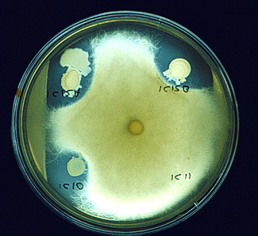
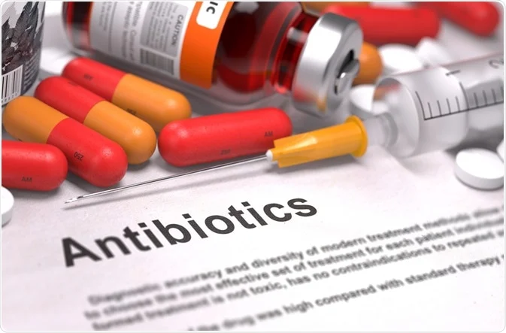
What are Antibiotics?
Antimicrobial drugs
“Against life”
Drugs that kills germs in our
body
Ineffective against virus

Slide 3
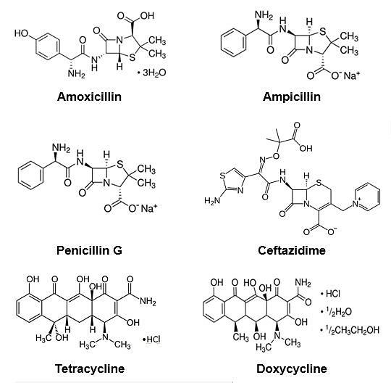
Structure
Formula of
studied antibiotics

Slide 4
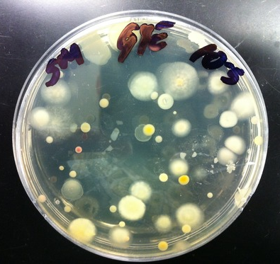
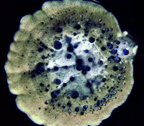
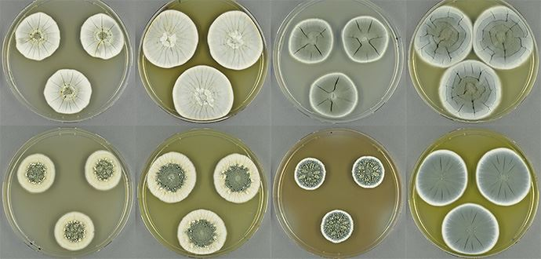
What are antibiotics made up of?
Soil microorganisms
Bacteria and Fungi

Slide 5
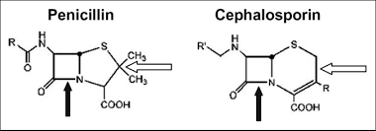
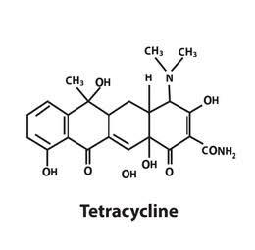
Types of Antibiotics
Penicillin
Cephalosporins
Fluoroquinolone
Tetracycline
Macrolides

Slide 6
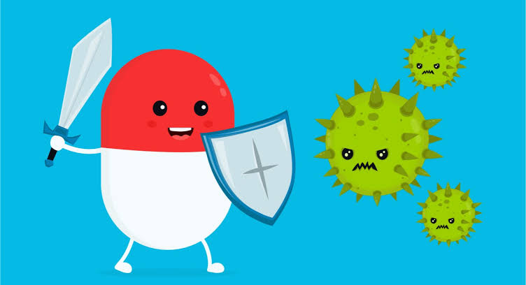
Why Antibiotic Is Important For Body
Life-saving medicines
Works against the organism causing infection
Stop bacteria from multiplying in the body
Risk of side effects and harm

Slide 7
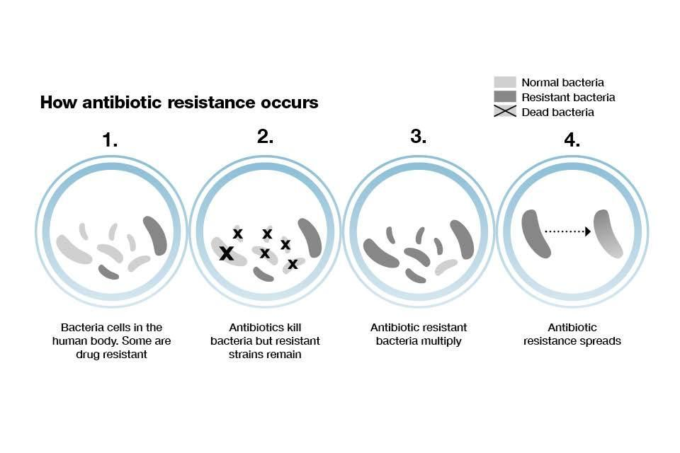
Adverse Effects of Antibiotics
Promotes antibiotic resistance
Causes allergic reaction
Leads to infection such as antibiotic associated diarrhea

Slide 8
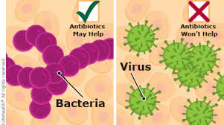
How to Take Antibiotics Safely
Avoid taking them for other infections except certain bacteria
Take them after consulting with a doctor
Finish the prescribed doses even if you feel better in the midway
Consult with your doctor if you develop any side effect

Slide 9
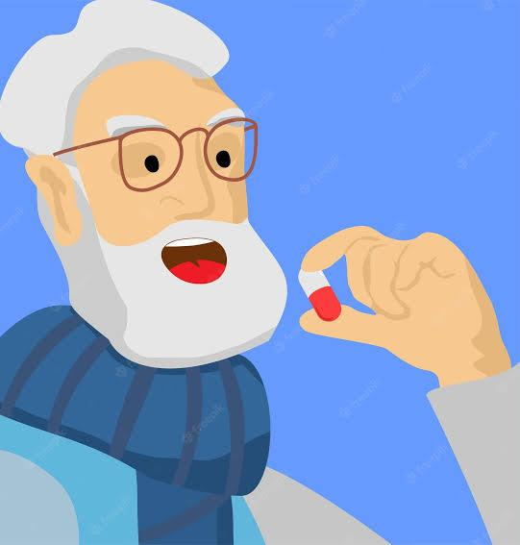
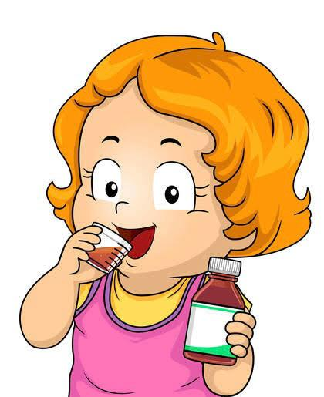
Unnecessary Use/Overuse Misuse/Incorrect Prescription
Example : A 55-years old man is diagnosed with bronchitis and prescribed an antibiotic , even though national guidelines recommend against prescribing antibiotics for bronchitis .
Example : An 8-years-old girl is diagnosed with strep throat and needs an antibiotic to treat it , but the antibiotic prescribed is the wrong one , or the dose is too low , or the duration is too long .

Slide 10
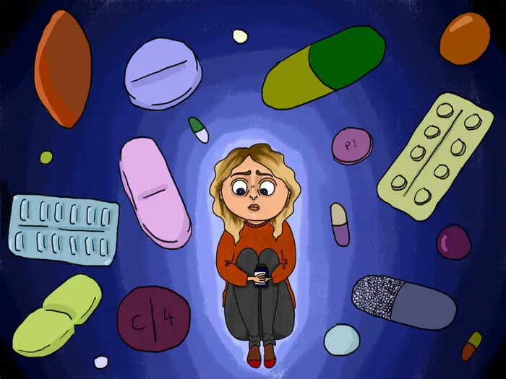
Misconception About Antibiotics
Antibiotics won’t cause resistance if I take them correctly
It’s our bodies that become resistant to the antibiotic
If I feel better, I can stop my antibiotics
I can take leftovers, or some from family or friends
Resistance only happens from repeated courses

Slide 11
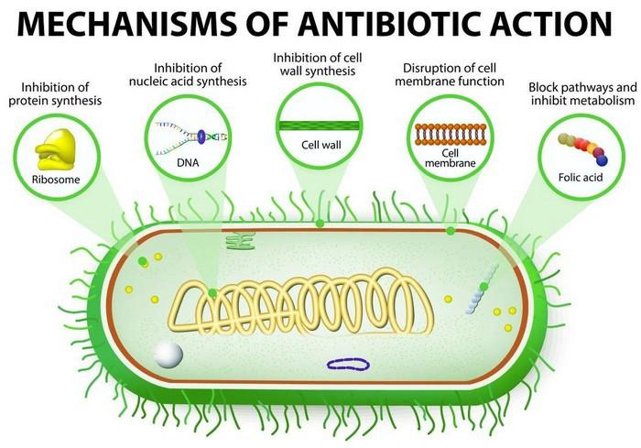
How does antibiotics work?
Destroys bacterial cell wall
Prevents growth of bacteria
such as - disrupts bacteria cells
to produce folic acid
Inhibits protein synthesis of bacteria
Prevents successful DNA
replication of bacteria

Slide 12

Conclusion
A medication that stops the growth of germs or kills them
Helps our immune system
Pharmacists are attempting to increase the
potency of antibiotics while minimizing their negative effects.
Antibiotics resistance might create a global emergency situation as it decreases built-in immunity system
Antibiotics should be taken according to doctor’s suggestion

Slide 13
Thank you !

